Slide 1
Computer Networks
Lecture 1 (Introduction and basic concepts)

Slide 2
NETWORKS
A network is a set of devices (often referred to as nodes) connected by communication links. A node can be a computer, printer, or any other device capable of sending and/or receiving data generated by other nodes on the network.
“Computer network’’ to mean a collection of autonomous computers interconnected by a single technology. Two computers are said to be interconnected if they are able to exchange information.
The connection need not be via a copper wire; fiber optics, microwaves, infrared, and communication satellites can also be used.

Slide 3
NETWORKS
Networks come in many sizes, shapes and forms, as we will see later. They are usually connected together to make larger networks, with the Internet being the most well-known example of a network of networks.
There is considerable confusion in the literature between a computer network and a distributed system.The key distinction is that in a distributed system, a collection of independent computers appears to its users as a single coherent system. Usually, it has a single model or paradigm that it presents to the users.
Often a layer of software on top of the operating system, called middleware, is responsible for implementing this model. A well-known example of a distributed system is the World Wide Web. It runs on top of the Internet and presents a model in which everything looks like a document (Web page).

Slide 4
USES OF COMPUTER NETWORKS
Business Applications
to distribute information throughout the company (resource sharing). sharing physical resources such as printers, and tape backup systems, is sharing information.
client-server model.
It is widely used and forms the basis of much network usage.
communication medium among employees .email (electronic mail), which employees generally use for a great deal of daily communication.
Telephone calls between employees may be carried by the computer network instead of by the phone company. This technology is called IP telephony or Voice over IP (VoIP) when Internet technology is used.
Desktop sharing lets remote workers see and interact with a graphical computer screen • doing business electronically, especially with customers and suppliers. This new model is called e-commerce (electronic commerce) and it has grown rapidly in recent years.

Slide 5
USES OF COMPUTER NETWORKS
Home Applications
peer-to-peer communication
person-to-person communication
electronic commerce
entertainment.(game playing,)

Slide 6
USES OF COMPUTER NETWORKS
Mobile Users
Text messaging or texting
Smart phones,
GPS (Global Positioning System)
m-commerce
NFC (Near Field Communication)

Slide 7
Effectiveness of Data communication
The effectiveness of a data communications system depends on four fundamental characteristics: delivery, accuracy, timeliness, and jitter
I. Delivery. The system must deliver data to the correct destination. Data must be received by the intended device or user and only by that device or user.
2 Accuracy. The system must deliver the data accurately. Data that have been altered in transmission and left uncorrected are unusable.
3. Timeliness. The system must deliver data in a timely manner. Data delivered late are useless. In the case of video and audio, timely delivery means delivering data as they are produced, in the same order that they are produced, and without significant delay. This kind of delivery is called real-time transmission.

Slide 8
Effectiveness of Data communication
4. Jitter.
Jitter refers to the variation in the packet arrival time. It is the uneven delay in the delivery of audio or video packets. For example, let us assume that video packets are sent every 30 ms. If some of the packets arrive with 30-ms delay and others with 40-ms delay, an uneven quality in the video is the result.

Slide 9
Components of Data Communication
A data communications system has five components
I. Message. The message is the information (data) to be communicated. Popular forms of information include text, numbers, pictures, audio, and video.
2 Sender. The sender is the device that sends the data message. It can be a computer, workstation, telephone handset, video camera, and so on.
3. Receiver. The receiver is the device that receives the message. It can be a computer, workstation, telephone handset, television, and so on.

Slide 10
Components of Data Communication
4. Transmission medium. The transmission medium is the physical path by which a message travels from sender to receiver. Some examples of transmission media include twisted-pair wire, coaxial cable, fiber-optic cable, and radio waves.
5. Protocol.
A protocol is a set of rules that govern data communications. It represents an agreement between the communicating devices. Without a protocol, two devices may be connected but not communicating, just as a person speaking French cannot be understood by a person who speaks only Japanese.

Slide 11
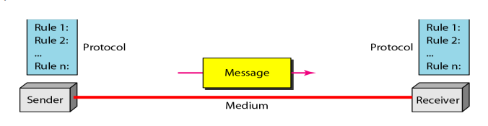
Components of Data Communication

Slide 12
Data Flow
Communication between two devices can be simplex, half-duplex, or full-duplex.
Simplex In simplex mode, the communication is unidirectional, as on a oneway street. Only one of the two devices on a link can transmit; the other can only receive (Figure a). Keyboards and traditional monitors are examples of simplex devices.
Half-Duplex In half-duplex mode, each station can both transmit and receive, but not at the same time. When one device is sending, the other can only receive, and vice versa (Figure b). Walkie-talkies and CB (citizens band) radios are both halfduplex systems.
Full-Duplex In full-duplex, both stations can transmit and receive simultaneously (Figure c). One common example of full-duplex communication is the telephone network. When two people are communicating by a telephone line, both can talk and listen at the same time. The full-duplex mode is used when communication in both directions is required all the time.

Slide 13
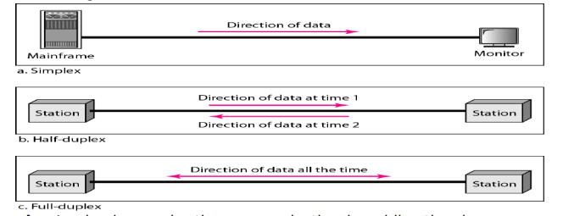
Data Flow

Slide 14
Network Criteria
A network must be able to meet a certain number of criteria. The most important of these are performance, reliability, and security.
Performance Performance can be measured in many ways, including transit time and response time. Transit time is the amount of time required for a message to travel from one device to another. Response time is the elapsed time between an inquiry and a response. The performance of a network depends on a number of factors, including the number of users, the type of transmission medium, the capabilities of the connected hardware, and the efficiency of the software. Performance is often evaluated by two networking metrics: throughput and delay. We often need more throughput and less delay. However, these two criteria are often contradictory. If we try to send more data to the network, we may increase throughput but we increase the delay because of traffic congestion in the network.

Slide 15
Network Criteria
Reliability: In addition to accuracy of delivery, network reliability is measured by the frequency of failure, the time it takes a link to recover from a failure, and the network's robustness in a catastrophe.
Security: Network security issues include protecting data from unauthorized access, protecting data from damage and development, and implementing policies and procedures for recovery from breaches and data losses.

